Slide 1


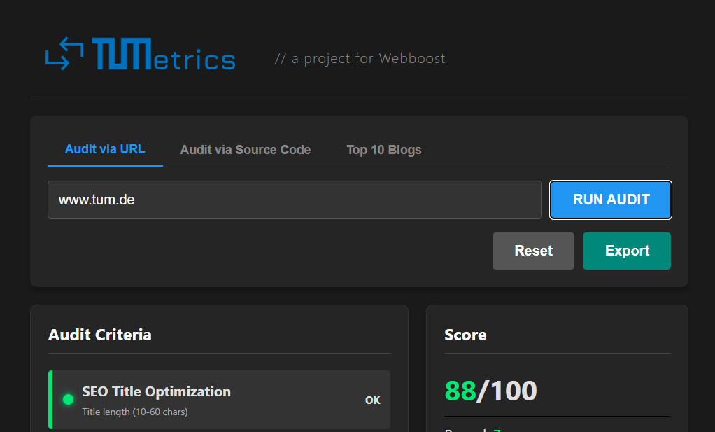
Welcome to
Turning insights into actionable recommendations
Project Creators
Eni Ferizi, Amin Durguti, Marcel Zuhhman

Slide 2

The Problem
In today’s crowded digital landscape, niche content alone is not enough. Even high-quality content can get lost if the website:
01
02
03
Has poor user experience
Has ineffective layout or structure
Lacks visibility
Creators need a holistic approach to ensure their website stands out, engages visitors, and ranks well

Slide 3

The Challenge
The WEBBOOST challenge was to create a tool that analyzes a creator’s website and generates practical recommendations to improve content, user experience, and overall website performance without relying on external or social media data.
For example, food blogs or recipe websites could benefit from insights on readability, content depth, and layout optimization.

Slide 4
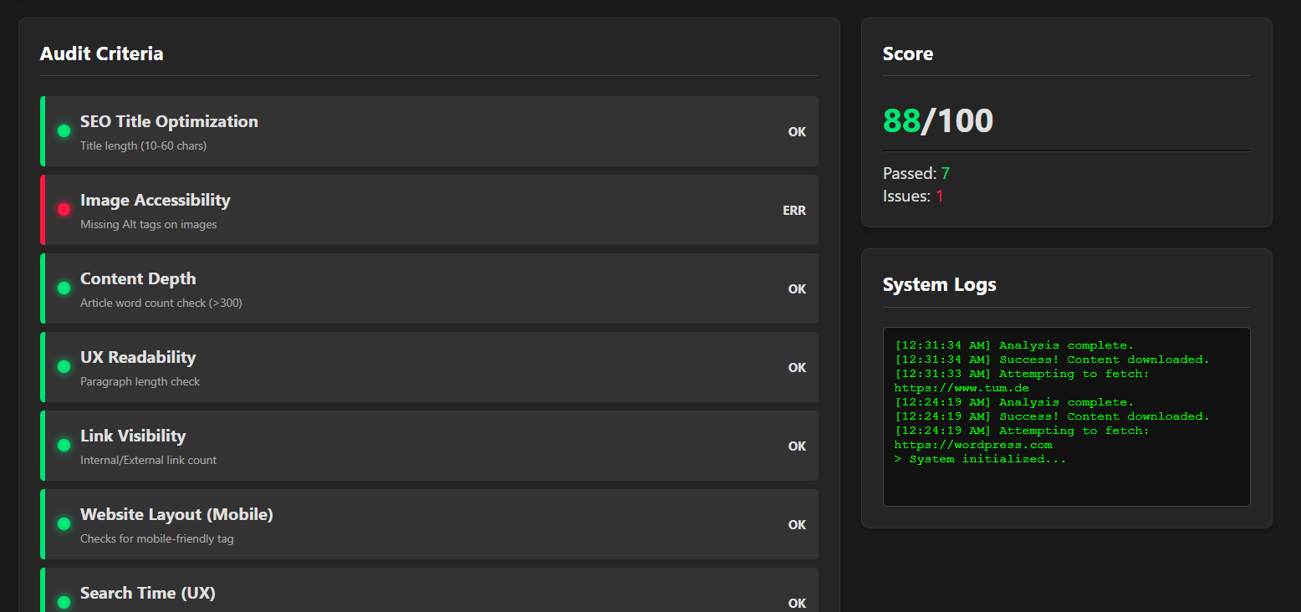
Our Solution - TUMetrics
TUMmetrics evaluates blogging websites across key performance criteria, assigns a score out of 100, and provides AI-powered recommendations for improvement.
It allows creators to quickly understand where their site is strong and where it needs improvement, helping them optimize their websites for readers and search engines alike.

Slide 5

How It Works
TUMmetrics evaluates websites based on eight main criteria:
1. *SEO Title Optimization* Are titles the right length for search engines?
2. *Image Accessibility* Are images missing Alt tags?
3. *Content Depth* Does the article meet a minimum word count?
4. *UX Readability* Are paragraphs readable and not too long?
5. *Link Visibility* Are internal and external links properly structured?
6. *Website Layout (Mobile)* Is the site mobile-friendly?
7. *Search Time (UX)* How long until the user finds what it needs?
8. *Annoyance Level (Ads)* Do ads interfere with user experience?

Slide 6
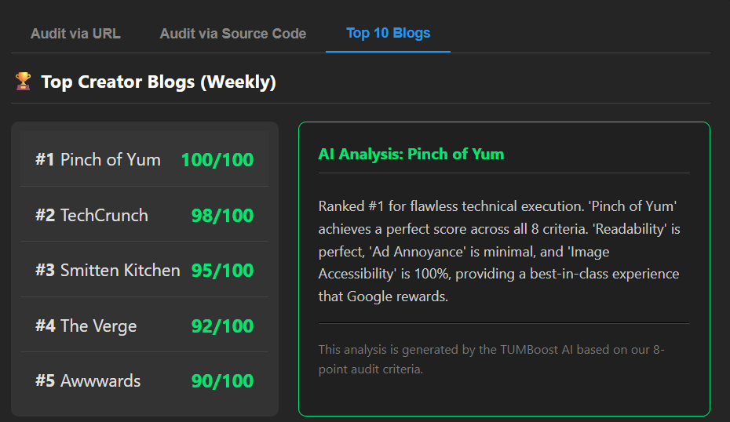
Special Features
These are a few of the main features that set us apart
01
Top 5 Blogging Websites:
Discover how your website ranks compared to the top blogs in your niche, and get insights on the most relevant platforms to follow and engage with.
02
AI-Powered Recommendations:
With help from Gemini the AI analyzes your website, explains issues in plain language, and suggests actionable improvements for content

Slide 7
Results/Impact
Using TUMetrics, creators can:
* Quickly identify weaknesses in content, UX, and SEO
* Improve website readability and performance
* Benchmark their site against the top 10 blogs
* Receive actionable AI recommendations to increase engagement.

Slide 8

Future Improvements
Our roadmap includes:
* Deeper analytics to detect trends in content and engagement
* Personalized recommendations for different blog niches
* Continuous monitoring to track improvements over time
TUMetrics aims to evolve into a full-scale platform that helps creators grow and optimize their websites effectively.

Slide 9
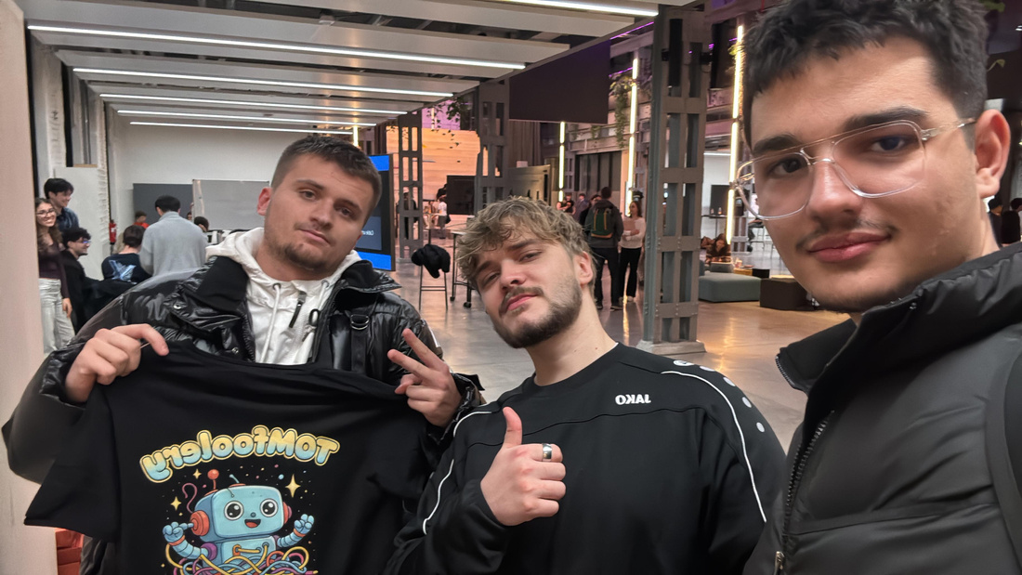
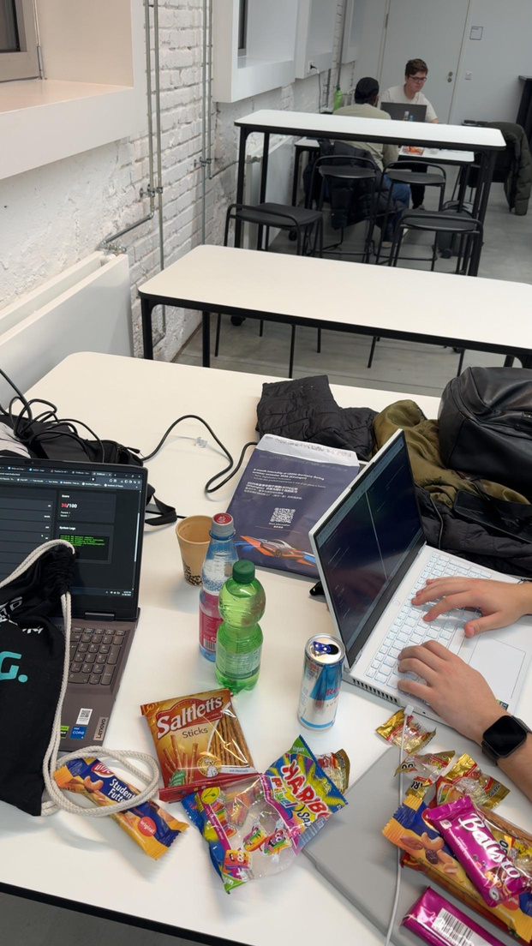
Thank you for your attention.
We really enjoyed this hackathon and are excited to see if our project comes out on top

